Slide 1
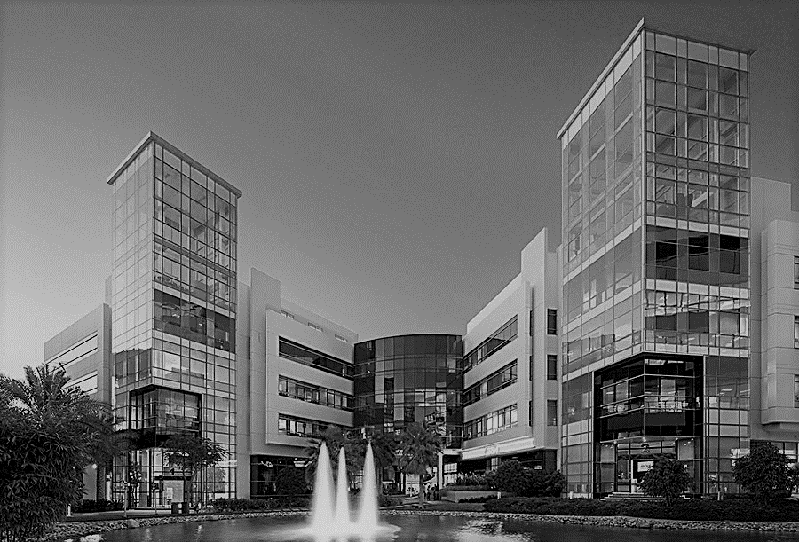

Process | Technology | People | Outsourcing | Managed Solutions
Building 4, Ground Floor, Dubai Outsource City, Dubai, UAE
www.backofficeme.com | enquiry@backofficeme.com

Slide 2
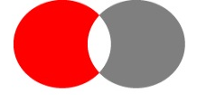
About Back Office
18+
Years
100+
Corporate Clients
350+
Employees
6 Offices DXB | KHI | LHR
We provide business, process and technology outsourcing services, including but not limited to, contact center, custom-built software solutions, records management and HR outsourcing solutions.
For over 18 years, Back Office has been a trusted partner to provide managed solutions to banking, health care, retail, FMCG, consumer electronics, manufacturing, and services verticals.
ISO Certified 27001:2013

Slide 3
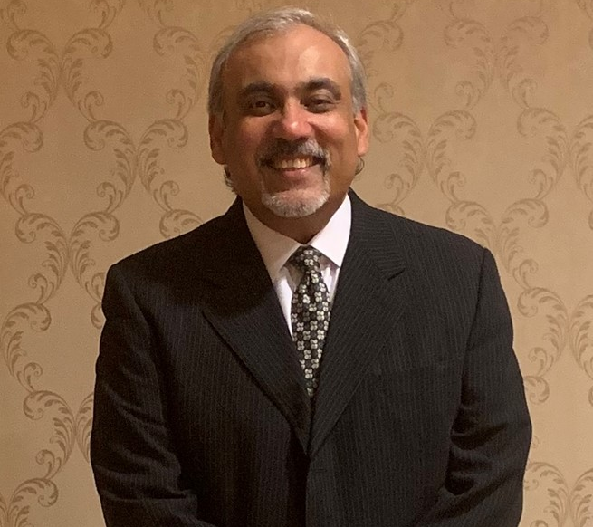
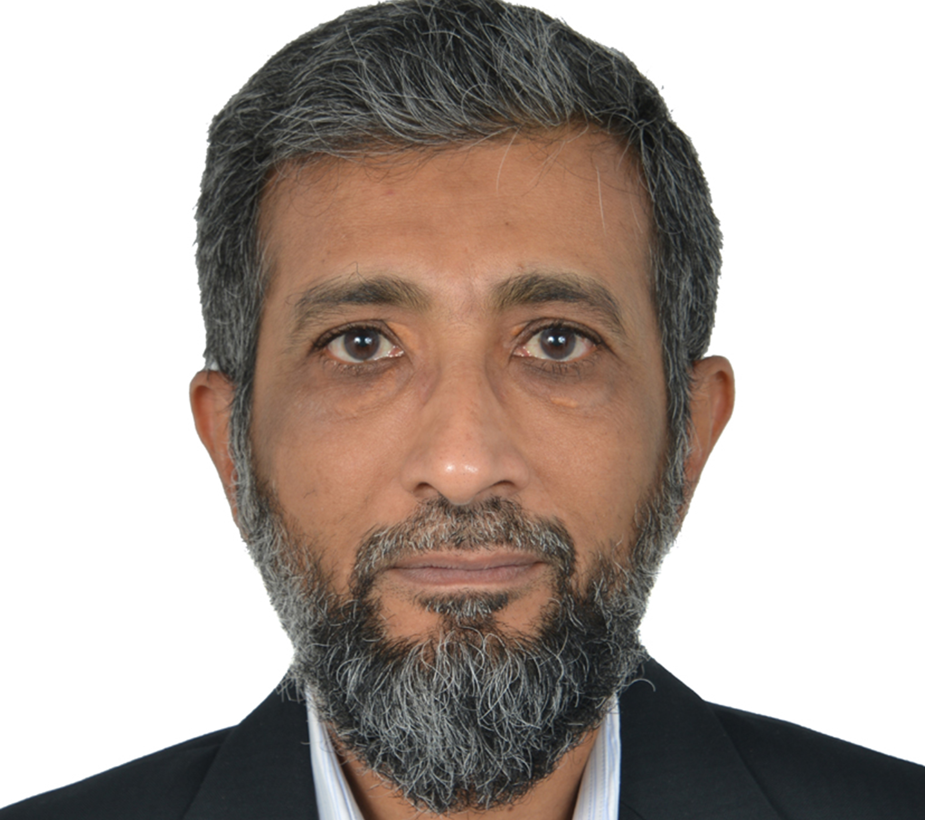
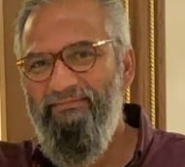
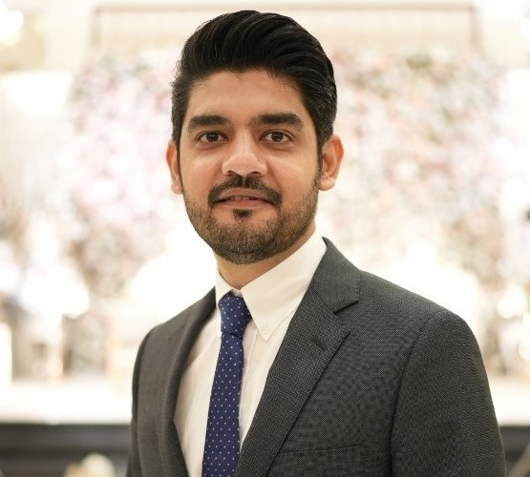
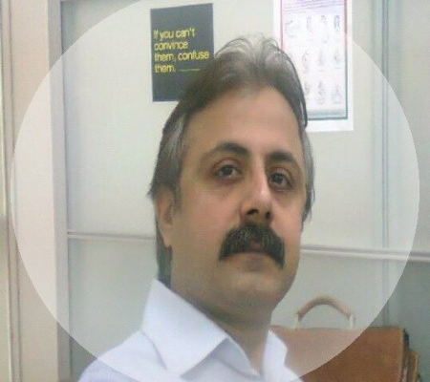
Our Core Team
Ali Kazmi
Ali Rahim
Chief Executive Officer
Principal Advisor
Jehangir Makhdum
Zeeshan Saeed
Atif Pasha
Managing Director
Chief Operating Officer
Business Head – Pakistan

Slide 4
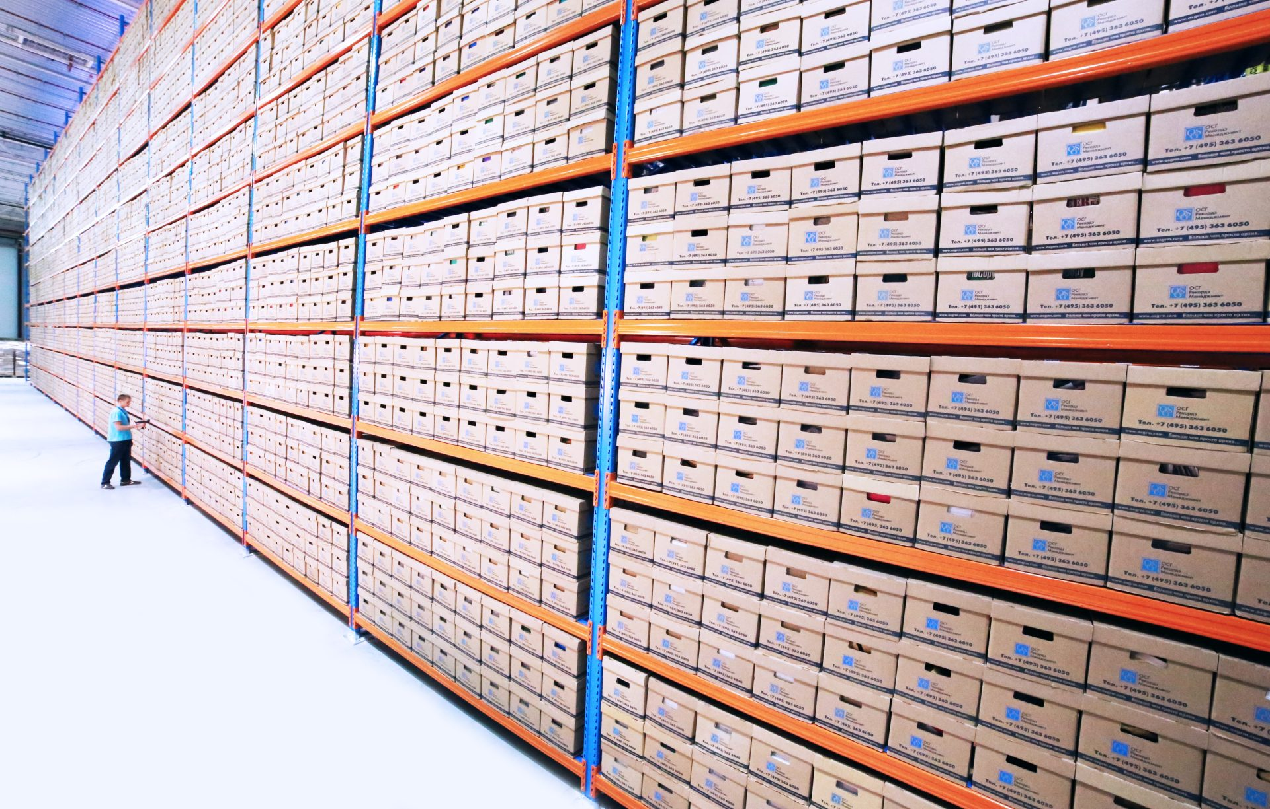



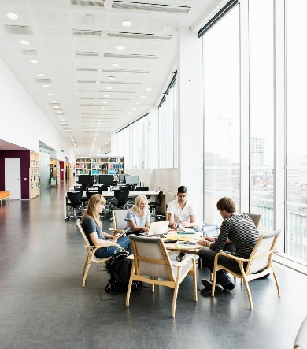
Our Services
Records Management
Contact Center
Software Development
Banking Solutions
Co-Working Space
Physical and Digital Records & Information Management
24 x 7 Inbound & Outbound Contact Center
Custom Built Technology Solutions
Back Office Operations & Transaction Processing
Smart, Simplified & Flexible Coworking Spaces

Slide 5




Our Focus Areas
Technology
Customers
Process
Tools that empower businesses to control end-to-end processes through digitalized workflows
All Processes, Technology, People & Employees have one common goal; Customer First
People
Customer centric processes to provide flexible and agile solutions.
Source, Train and Provide specialized resources to meet business needs

Slide 6



































Our Key Clients

Slide 7
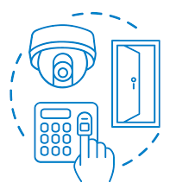


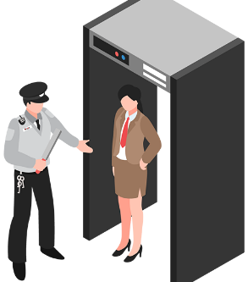
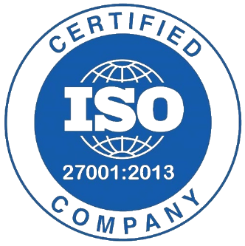
Records & Information Management
Security
Smoke Detection & Sprinkler System
Pest & Rodent Control
Onsite Security Personnel 24 x 7
ISO Certified
Fully Equipped with CCTV and Access Controls
Equipped with ESFR Sprinkler system linked with Civil Defence Authority
Pest control at different levels to mitigate the risk of insects & rodents colonization
24 x 7 Physical Security
ISO 27001:2013 Certified and Compliant with various International Standards to ensure data security & integrity

Slide 8
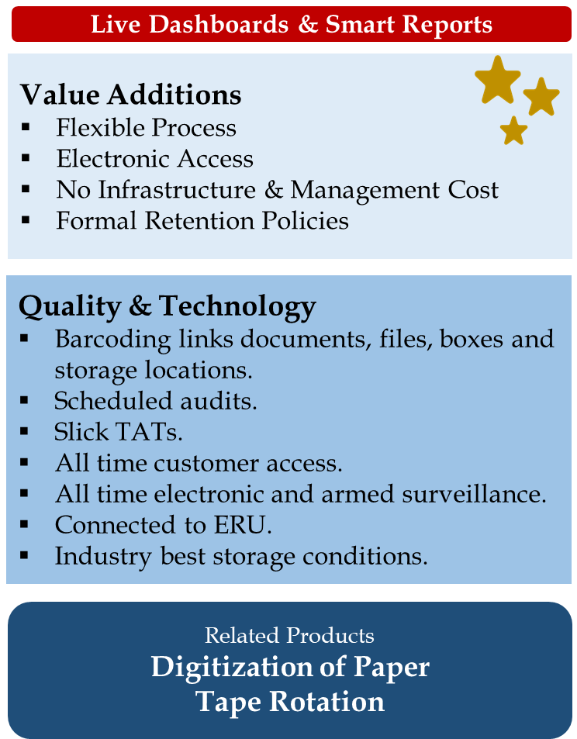
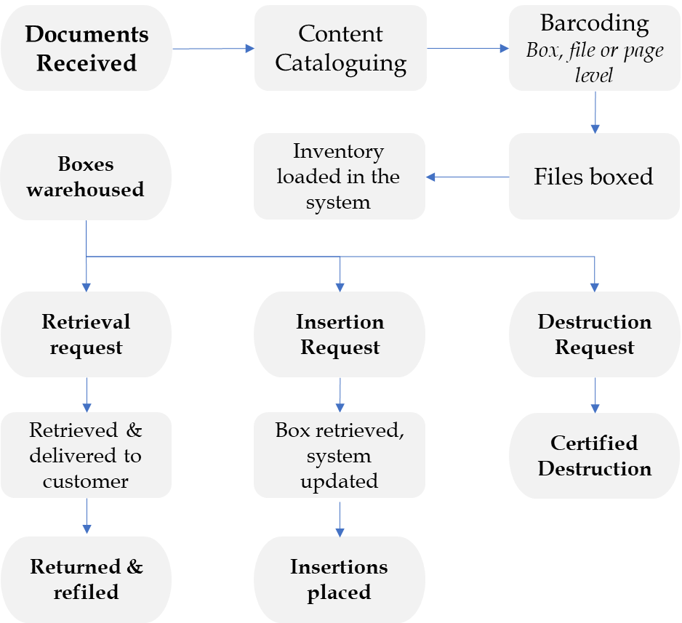
Records Management, Generic Process

Slide 9



Document Imaging & Scanning
Scanning Capabilities
Specialize in both ongoing (business as usual) and back-file conversion scanning/imaging projects
Capacity to convert documents ranging in sizes from A4 to up to A0+ sizes
Industry Best Technology
Utilize technology from Kodak, Kofax, Oce, Canon, and Hewlett Packard
Proprietary EDMS
Proprietary document management system that can be customized as per the client’s requirements

Slide 10
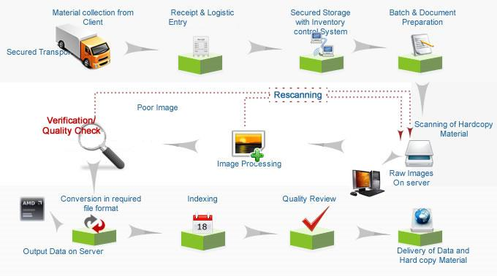
Generic Scanning Workflow

Slide 11
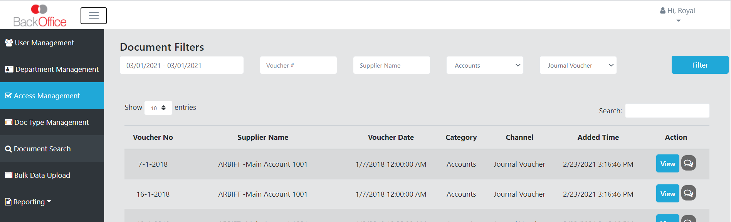
Doc Drive – Document Management System
A proprietary document management system that is customized as per the client’s requirements.
Two options, Client-Server basis or Web based modules.
Functionalities based on user login, enabling or controlling document access, print, email, etc.
Detail administration and users reporting
Annual upgrades – keeping abreast with the changing technology

Slide 12
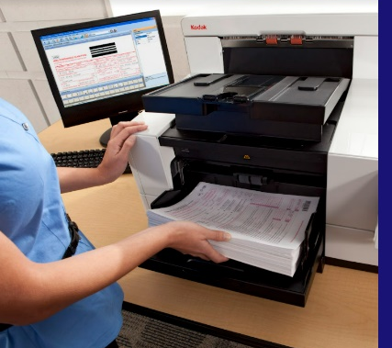
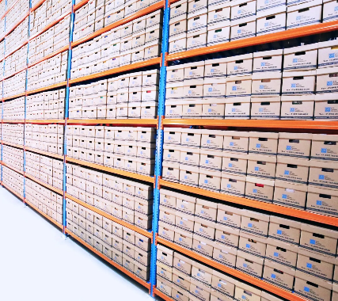
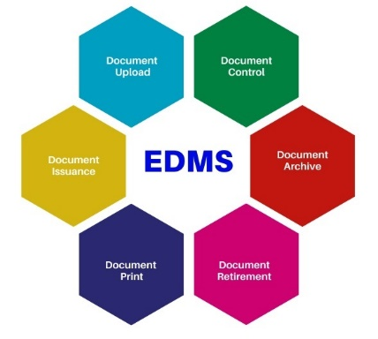
Records Management – Summary & Experience
Document Imaging & Scanning
Physical Documents Management
Digitization of 200 Million Documents
Proprietary EDMS
Managing Storage of 700,000+ Boxes
Handle Over 16 Million Transactions Annually

Slide 13
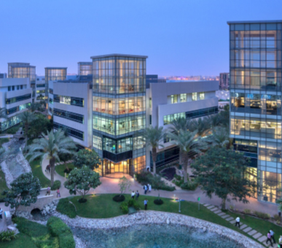

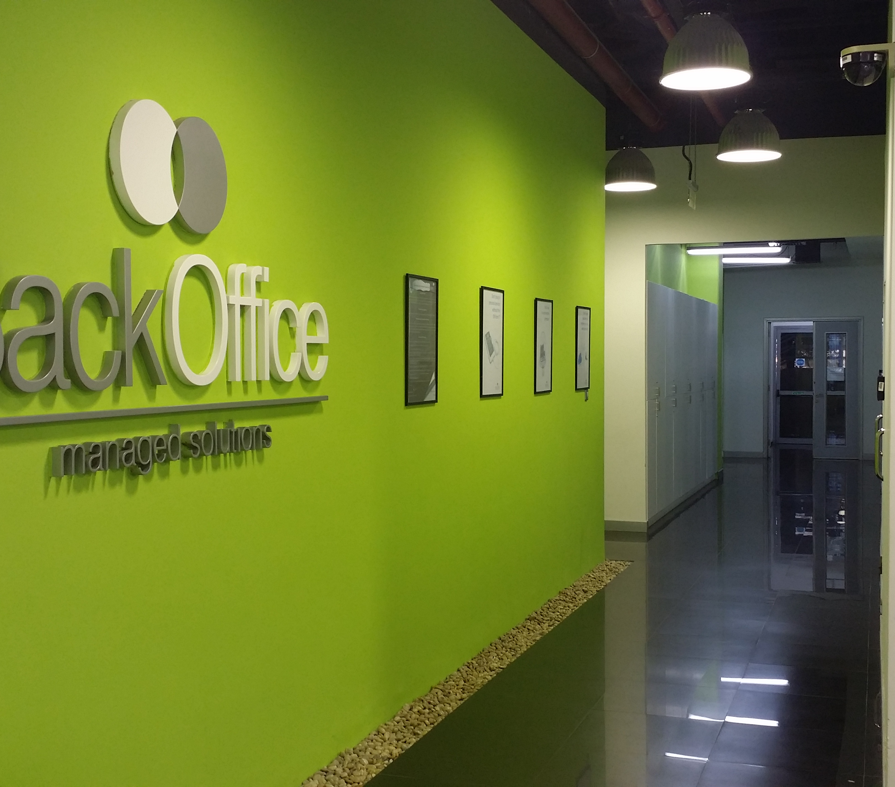
Thank you
Zeeshan Saeed
Zeeshan.Saeed@BackOfficeME.com
www.backofficeme.com

